Slide 1
Grey Hats at UHM
Fall 2016

Slide 2
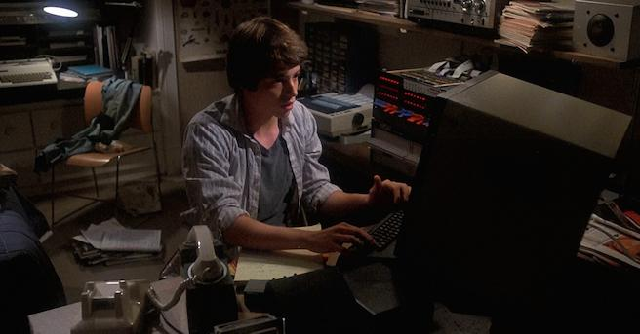
Who Are We?
-Cyber-security enthusiast -Registered RIO -Not limited to ICS majors -Participate in monthly competitions -Any skill level can join -No previous experience needed
Learn about: -Network protocol and packet analysis
-Program debugging and patching -Binary analysis

Slide 3
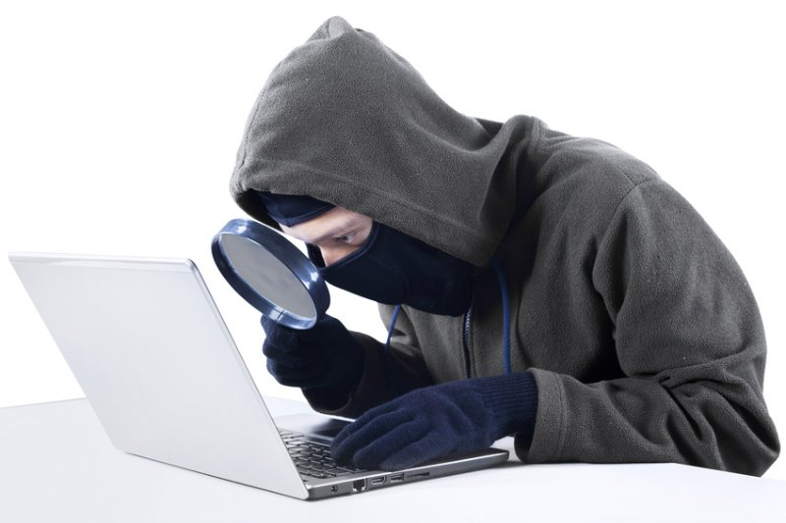

What Is Hacking?
You think it’s this…
But it actually this...

Slide 4
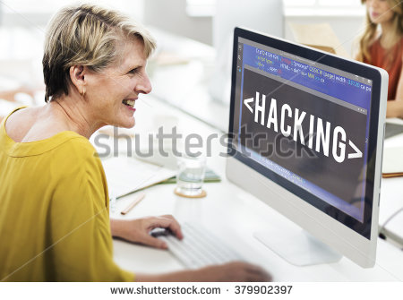
First Meeting
Wednesday, August 31 at 4:30pm, POST 3XX
Required: -Liability waiver -Curious attitude Optional: -Computer -Spare USB drive

Slide 5
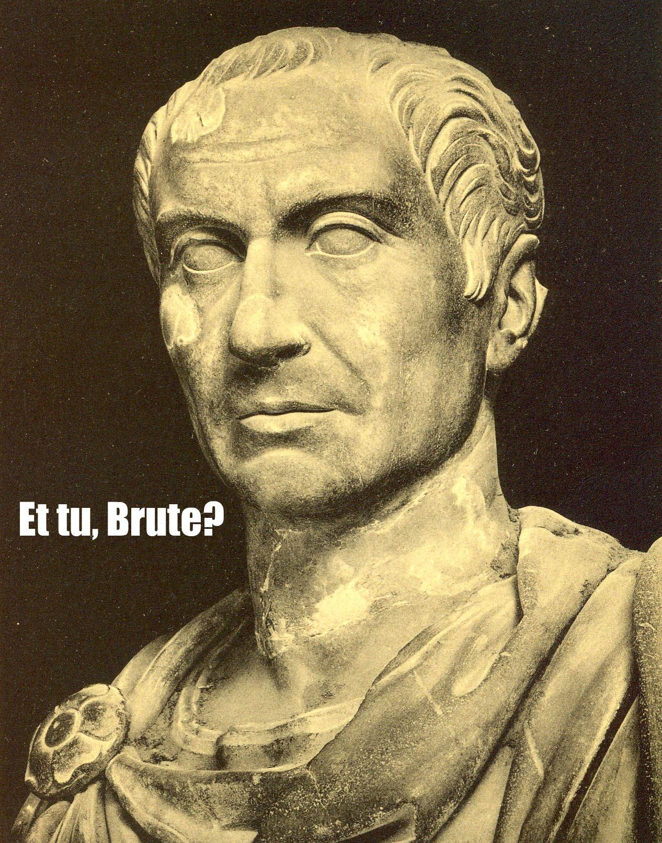
Challenge
GSRKVEHYPEXMSRW SR HIGMTLIVMRK XLMW QIWWEKI M LSTI XS WII CSY EX SYV JMVWX QIIXMRK
https://github.com/uhmgreyhats/getting-started

